Slide 1
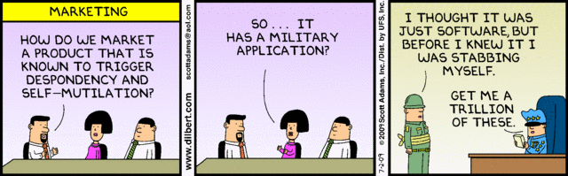
Software Engineering
Lecture 2 – The Context of Software Architecture

Slide 2
Last time
Course introduction
Has everyone found a group?
All assignments are group assignments
Except for the Home Exam which is handed in individually

Slide 3
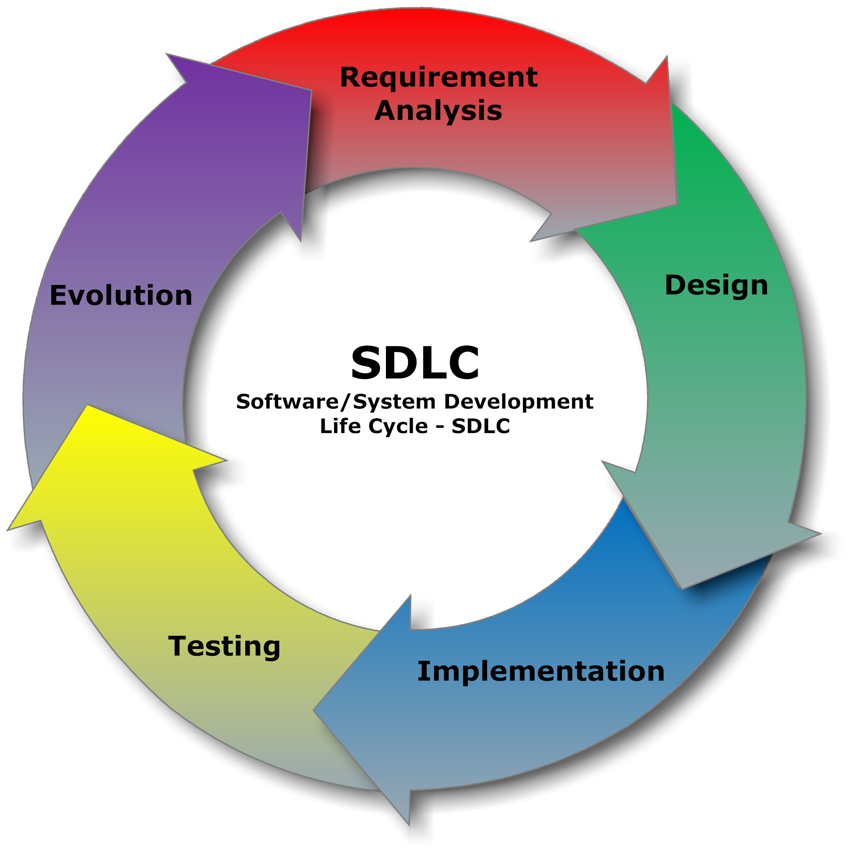
Software development lifecycle

Slide 4
Why is software architecture important?

Slide 5
Quality Software, On Time, and Within Budget

Slide 6
Software architecture
Communicate design
Quality attributes
Features
How to work with the code
Manage change
Developer creativity
Cost and schedule
Find faults early
Of interest for many stakeholders

Slide 7
Why is software architecture important?
Will inhibit or enable driving quality attributes
Allows management of change as it evolves
Early prediction of a system’s qualities
Enhance communication among stakeholders
Fundamental design decisions
Constraints on subsequent implementation
Dictates the structure of an organization
Basis for evolutionary prototyping

Slide 8
Why is software architecture important?
Allows reasoning about cost and schedule
Transferable, reusable model that form the heart of a product line
Assembly of components, rather than simply on their creations
Channels the creativity of developers, reducing design and system complexity
Foundation for training a new team member

Slide 9
Aim of this lecture
To understand how different areas are affected by software architecture
Where does architecture fit into the software development lifecycle?
What does architecture influence?

Slide 10
Software architecture

Slide 11

The architect
https://www.youtube.com/watch?v=sQCBfuV5qVg first 5:30 minutes
https://www.youtube.com/watch?v=sQCBfuV5qVg

Slide 12
Fundamental Understanding
Every application has an architecture
Every application has at least one architecture
Architecture is not a phase of development

Slide 13
Wrong View: Architecture as a Phase
More than “high-level design”
also represented, e.g. by object code, source code, …

Slide 14
Context of Software Architecture
Requirements
Design
Implementation
Analysis and Testing
Evolution
Development Process

Slide 15
Software development lifecycle

Slide 16
Context of Software Architecture
Requirements
Design
Implementation
Analysis and Testing
Evolution
Development Process

Slide 17
Requirements Analysis
Traditionally: requirements analysis is done independently of design
without reference to existing architectures it becomes difficult to assess practicality, schedules, or costs
new products come from the observation of existing solution and their limitations
How can we do requirements analysis more efficiently?
Notes:
In building architecture we talk about specific rooms…
…rather than the abstract concept “means for providing shelter”

Slide 18
New Perspective on Requirements Analysis
Existing designs and architectures provide the solution vocabulary
Our understanding of what works now, and how it works, affects our wants and needs
Our experiences with existing systems
helps us imagine what might work and
enables us to assess development time and costs
→ Requirements analysis and consideration of design must be pursued at the same time
What can happen if we don’t consider requirements analysis and design at the same time?

Slide 19

The regal ship Vasa
Could have been avoided by:
Utilizing successful architectural practices
Using methods for assessing the architecture
Incremental architectural-based development
Find faults early

Slide 20
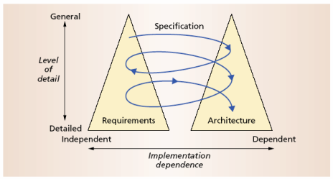
The Twin Peaks Model

Slide 21
Context of Software Architecture
Requirements
Design
Implementation
Analysis and Testing
Evolution
Development Process

Slide 22
Design and Architecture
Traditional Design Phase decisions concern
A system’s structure
Identification of its primary components
Their interconnections
More than just structure

Slide 23
Architecture-Centric Design
Traditional design suggests translating requirements into algorithms, so a programmer can implement them
Architecture-centric design
stakeholder issues
decision about use of off-the-shelf components
overarching style and structure
package and primary class structure
deployment issues
post implementation/deployment issues

Slide 24

5 minute break

Slide 25
Context of Software Architecture
Requirements
Design
Implementation
Analysis and Testing
Evolution
Development Process

Slide 26
Implementation
[Cited from https://github.com/ReactiveX/RxJava/issues/1661 by headinthebox]
… we should not forget that ultimately it is all (and only) about code (http://www.wired.com/2012/02/zuck-letter/).
Hacking is also an inherently hands-on and active discipline.
Instead of debating for days whether a new idea is possible
or what the best way to build something is, hackers would
rather just prototype something and see what works.
There’s a hacker mantra that you’ll hear a lot around Facebook offices: “Code wins arguments.”
No code base I have worked on had any design documents that you can rely on to understand the architecture of the code (if it exists, it is out of date in less than a week, anything artifact that does not break the build is not worth maintaining), the best skill student can learn is to dive into a giant code base and be up to speed quickly so they can contribute meaningfully.
Is this correct?
Notes:
Mark Zuckerberg talks about the hacker way as in releasing working code and then iterating it to improve its functionality. He does not condemn architecture, just longwinded discussions about feasibility.

Slide 27
Implementation
“Hacking” vs. Designing and implementing?
What are the consequences of focusing solely on producing working code?
When is “Hacking” appropriate, when is it not?

Slide 28
Implementation
The objective is to create machine-executable source code
That code should be faithful to the architecture
Alternatively, it may adapt the architecture
How much adaptation is allowed?
Architecturally-relevant vs. -unimportant adaptations

Slide 29
Faithful Implementation
All of the structural elements in the architecture are implemented
Source code must not utilize major new computational elements that have no corresponding elements in the architecture
Source code must not contain new connections between architectural elements that are not found in the architecture
Is this realistic? Overly constraining? What if we deviate from this?

Slide 30
Unfaithful Implementation
The implementation does have an architecture
It is latent, as opposed to what is documented.
Failure to recognize the distinction between planned and implemented architecture
robs one of the ability to reason about the application’s architecture in the future
misleads all stakeholders regarding what they believe they have as opposed to what they really have
makes any development or evolution strategy that is based on the documented (but inaccurate) architecture doomed to failure
Notes:
Latent : hidden, not yet realized or documented

Slide 31
Implementation Strategies
Generative techniques
e.g. parser generators
Frameworks
collections of source code with identified places where the engineer must “fill in the blanks”
Middleware
CORBA, DCOM, RPC, …
Reuse-based techniques
Commercial off-the-shelf, open-source, in-house
Writing all code manually
Notes:
Framework – set of tools, Middleware – manages interaction between systems/components

Slide 32
Context of Software Architecture
Requirements
Design
Implementation
Analysis and Testing
Evolution
Development Process

Slide 33
Analysis and Testing
assess the qualities of an artifact
The earlier an error is detected and corrected the lower the aggregate cost
Rigorous representations are required for analysis, so precise questions can be asked and answered

Slide 34
Analysis of Architectural Models
Formal architectural model can be examined for internal consistency and correctness
An analysis on a formal model can reveal
Component mismatch
Incomplete specifications
Undesired communication patterns
Deadlocks
Security flaws
It can be used for size and development time estimations

Slide 35
Analysis of Architectural Models (continued)
Architectural model
may be examined for consistency with requirements
may be used in determining analysis and testing strategies for source code
may be used to check if an implementation is faithful

Slide 36
Context of Software Architecture
Requirements
Design
Implementation
Analysis and Testing
Evolution
Development Process

Slide 37
Evolution and Maintenance
Software will evolve
Regardless of whether one is using an architecture-centric development process or not
The traditional software engineering approach to maintenance is largely ad hoc
Risk of architectural decay and overall quality degradation
Architecture-centric approach
Sustained focus on an explicit, substantive, modifiable, faithful architectural model

Slide 38
Context of Software Architecture
Requirements
Design
Implementation
Analysis and Testing
Evolution
Development Process

Slide 39
Discussion
How can you be faithful to the design?
How can you empower developer creativity?

Slide 40
Steps in any process
Making a business case for the system
Understanding the architecturally significant requirements
Creating or selecting the architecture
Documenting and communicating the architecture
Analyzing or evaluating the architecture
Implementing and testing the system based on the architecture
Ensuring that the implementation conforms to the architecture

Slide 41
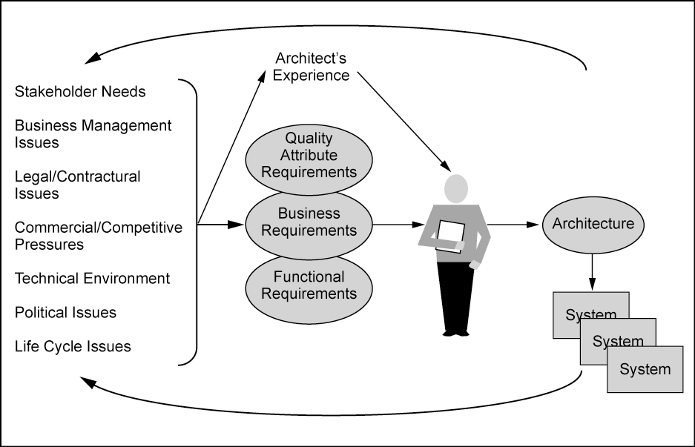
Architecture and business goals

Slide 42
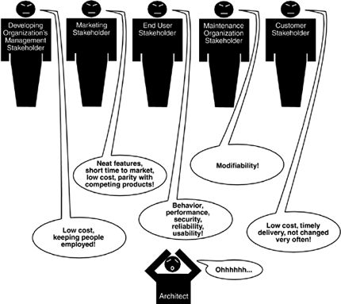
Stakeholders
p. 54-55

Slide 43
Summary (1)
software architecture affects every aspect of the classical software engineering activities
The requirements activity is a co-equal partner with design activities
The design activity is enriched by knowledge gained in previous product developments
The implementation activity
is centered on creating a faithful implementation of the architecture
utilizes a variety of techniques to achieve this in a cost-effective manner

Slide 44
Summary (2)
Analysis and testing activities can be focused on and guided by the architecture
Evolution activities revolve around the product’s architecture.
An equal focus on process and product results from a proper understanding of the role of software architecture

